Slide 1
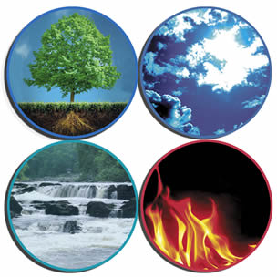
Are you more like earth, air, fire or water?

Slide 2
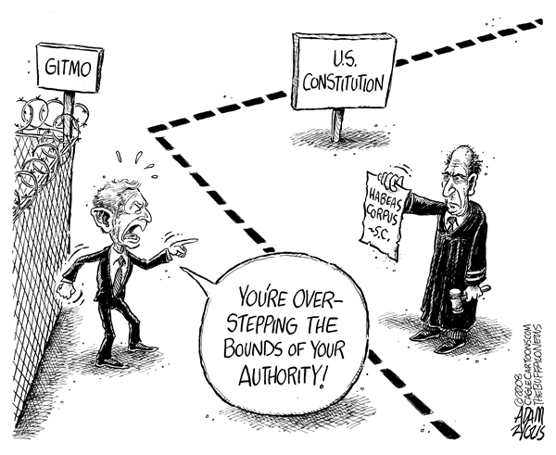
Examine the cartoon, what message is it trying to convey, what evidence supports your answer?

Slide 3
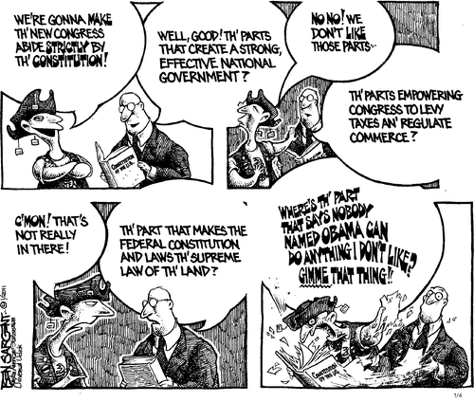
Examine the cartoon, what message is it trying to convey, what evidence supports your answer?

Slide 4
Students will read and write to peer review their rough drafts of their Constitutional Assessments using academic vocabulary advanced, proficient, partially proficient, and unsatisfactory.

Slide 5
Today you will work with your designated partner to peer review the
rough draft of your constitutional assessment.
You will use the peer review rubric to provide feedback to your assigned partner (you will be required to turn your the peer reviewed rubric for your paper with your final draft).

Slide 6
Create a metaphor or simile that describe the importance of the Constitution

