Slide 1
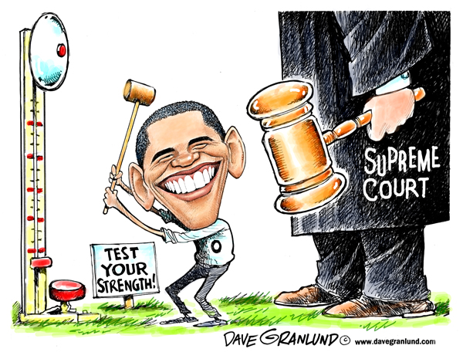
Examine the Cartoon, what Message is it trying to convey and what evidence supports your answer.
Record your answer in your notebook under today’s date

Slide 2
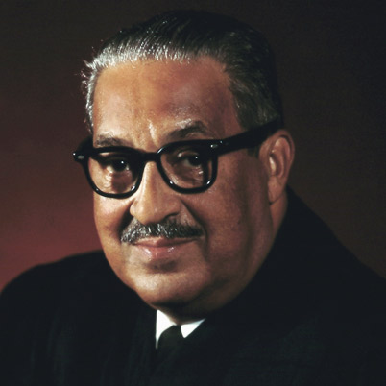
Watch the video and record notes on who Thurgood Marshall was and what were some of his major accomplishments?
Record your notes in your SS notebook under today’s date!!!

Slide 3
Students will read and speak to debate the issues of four contemporary Supreme Court cases that involve the Bill of Right using academic vocabulary Tinker v. Des Moines, Hazelwood School District v. Kuhlmeier, Wallace v. Jafree, New Jersey v. T.L.O.

Slide 4
Judicial Review
Who do the people on the sideline represent?
How does the power of Judicial Review make the Federal Courts more powerful?
Watch the following and record notes on Judicial Review and the checks against Judicial Power.

Slide 5
Analysis of Famous Court Cases
Case 1: Tinker v. Des Moines (1969)
Case 2: Hazelwood School District v. Kuhlmeier (1988)
Case 3: Wallace v. Jafree (1985)
Case 4: New Jersey v.T.L.O. (1985)

Slide 6
Exit Ticket
Now write to explain the importance of the Supreme Court using examples from our lesson today. Give three examples to support your answer and be sure to use academic vocabulary Tinker v. Des Moines, Hazelwood School District v. Kuhlmeier, Wallace v. Jafree, New Jersey v. T.L.O.

