Slide 1
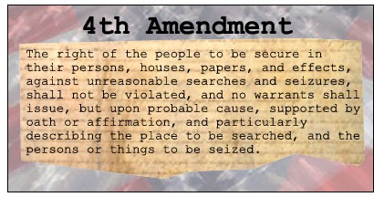
Under today’s date record the three things you are supposed to take notes on as you watch the video be sure to leave space to record notes between each heading.
Watch the video on the 4th Amendment and take notes on the origins of the Fourth Amendment, why it is controversial, and how it has evolved.

Slide 2
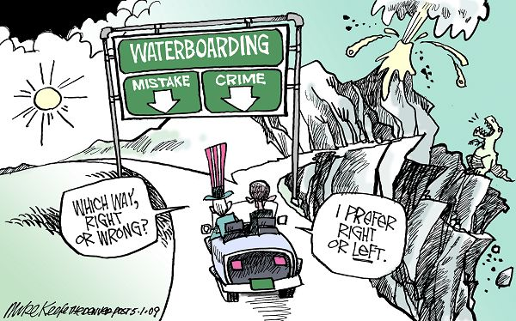
Examine the cartoon, what amendment in the Bill of Rights might this cartoon relate to and what evidence supports your answer?

Slide 3
CLO: Students will speak to explain the importance of the Bill of Rights and the rights contained in four of the amendments in the Bill of Rights by presenting a rap using academic language (rights, Bill of Rights, government, Constitution, prohibit, freedom, etc)

Slide 4
As you listen to each group evaluate the degree to which they met the requirements
on a scale of 1 through 5.
The requirements are that each group
4 Verses, each verse should explain the rights give in at least four amendments
Chorus that explains the importance of the Bill of Rights
Uses academic vocabulary (rights, Bill of Rights, government, Constitution, prohibit, freedom, etc)
On a sheet of paper that you will turn in for a grade, record the name of all of the group members, then for each requirement give a ranking and a brief justification for your ranking (3 ranking and 3 justification per group)

Slide 5
Now you will rank each groups ability to meet the requirements in their song. You will rank each group on scale of 1 to 5 and give a reason for your ranking. You will rank each group on the following three requirements.
4 Verses, each verse should explain the rights give in at least four amendments
Chorus that explains the importance of the Bill of Rights
Uses academic vocabulary (rights, Bill of Rights, government, Constitution, prohibit, freedom, etc)
You will turn in your rankings for each group

Slide 6
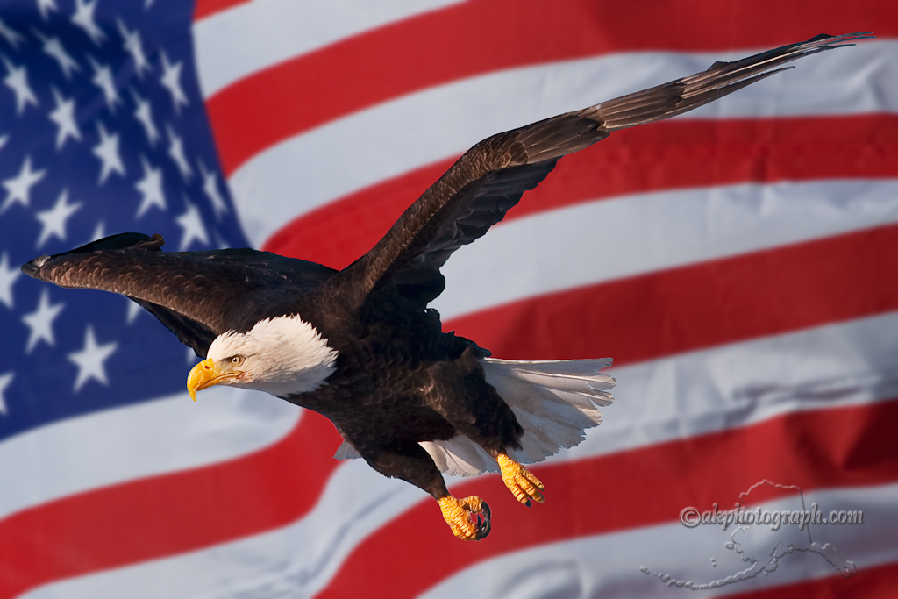

Slide 7
Exit Ticket
Evaluate the ability of the Bill of Rights to protect the rights of all citizens, give three reasons to support your answer.

